Slide 1
Introduction to Programming With JavaScript
Front-End Web Development

Slide 2
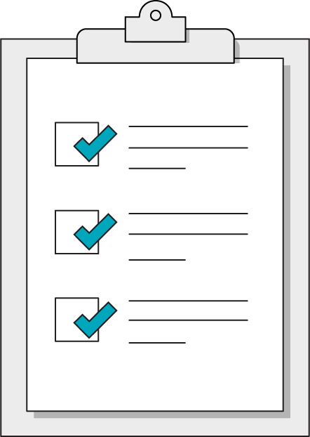
Today’s Learning Objectives
In this lesson, you will:
Distinguish between code and a program.
Define basic variables and data types in JavaScript.
Understand the role of functions in JavaScript.
‹#› | © 2021 General Assembly

Slide 3
What Is a Program?
Front-End Web Development

Slide 4
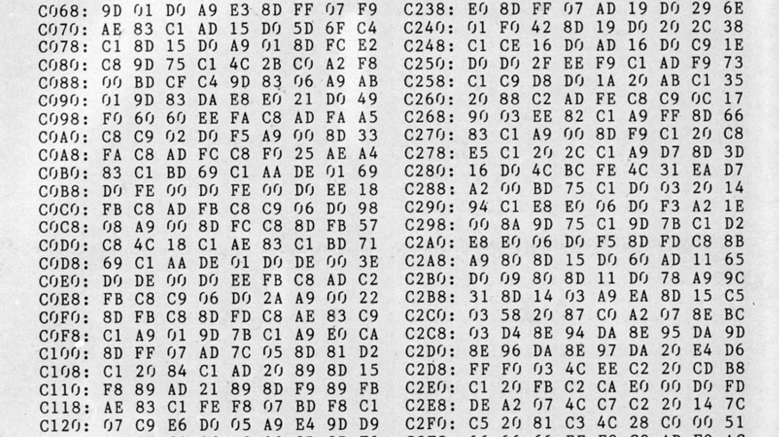
You Might Think a Program Is Code...

Slide 5
Code is HOW you make a program.
A program is just a set of INSTRUCTIONS.
‹#› | © 2021 General Assembly

Slide 6
The good news about computers is that they do what you tell them to do. The bad news is that they do what you tell them to do.
— Ted Nelson

Slide 7
Thinking Like a Computer
The art of programming requires understanding how a computer thinks:
It only knows what you tell it... | ...but it will remember what it’s been told.
It only understands a very limited set of phrases (syntax)... | ...but you can teach it a lot by combining these basic phrases together.
It will always do what you say... | ...but not necessarily what you meant.
It has no understanding of context... | ...but it’s not shy about saying when it doesn’t understand you (error messages).

Slide 8
Pseudocode is the process of writing a program without using the syntax of a programming language.
‹#› | © 2021 General Assembly

Slide 9
Variables
Functions
The Nouns of Programming
The Verbs of Programming
Pieces of data in a program that can used and changed many times.
These are used for anything you need the computer to remember or keep track of for later. If you would write it down, it’s a variable.
Modular, reusable containers for an instruction set.
These allow us to define building-block procedures that provide readable instructions for complex operations.
‹#› | © 2021 General Assembly

Slide 10

Thermostat
30 Minutes
Let’s create pseudocode for how a thermostat would work.
‹#› | © 2020 General Assembly

Slide 11
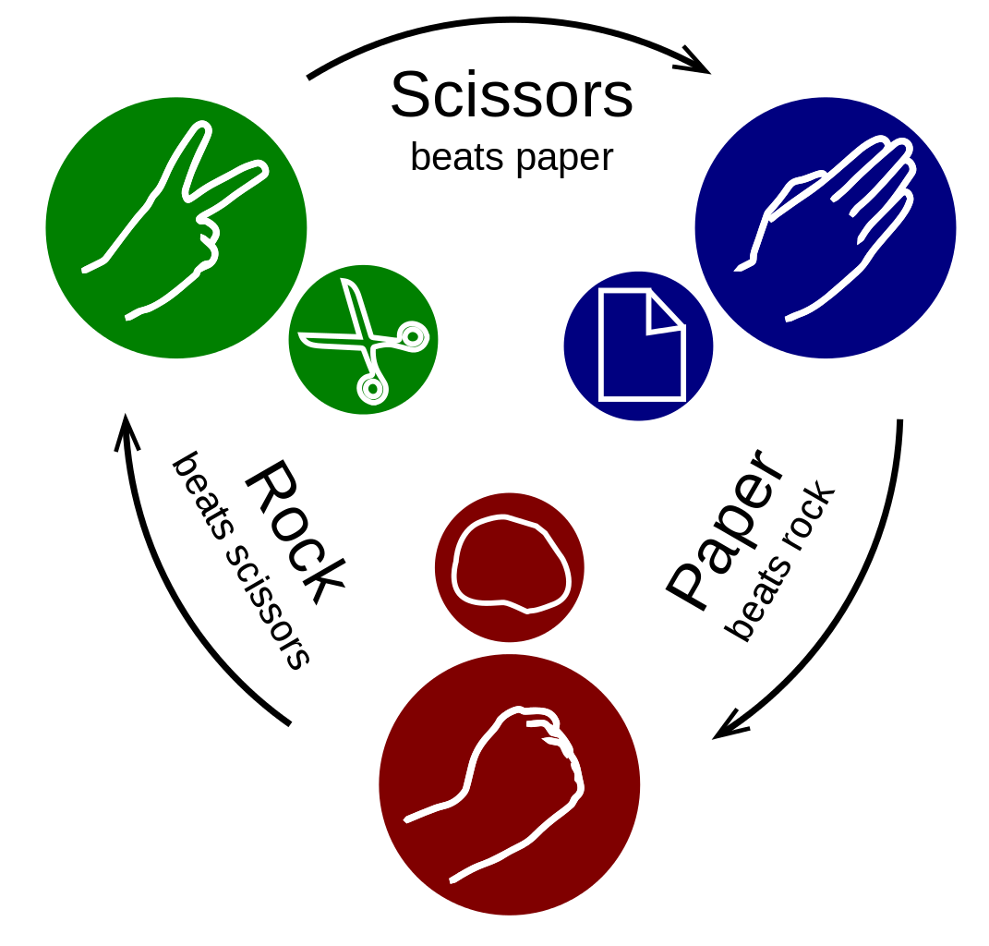
Rock, Paper, Scissors
30 Minutes
Let’s create pseudocode for how the Rock, Paper, Scissors game would work.
‹#› | © 2020 General Assembly

Slide 12
JavaScript is the most popular programming language. We’ll write JavaScript code to create programs that run in our browser along with our HTML & CSS.

Slide 13
JavaScript: The Basics
Front-End Web Development

Slide 14
JavaScript Reference Desk
You can reference the JavaScript concepts with examples in this CodePen:
Reference code:
https://drive.google.com/drive/folders/15S1w_lYLqORYpxZuSCDpuwcp68A_8KWb?usp=sharing

Slide 15

Basic Data Types
Numbers
Strings
Booleans
Null/undefined

Slide 16
Numbers
You've probably seen these before: 0, 1, 2, 3, 4, 5, 6, 7, 8, 9.
They are used mathematically throughout JS code, so normal math rules apply.
They are paired with operators: +, -, *, and /.
10 * 10 ⇒ 100
8 - 4 ⇒ 4
49 / 7 ⇒ 7
They can also include floating point numbers — i.e., decimals or floats.
8.99 + 2 => 10.99

Slide 17
Strings
String means text — that's it!
"It is a beautiful evening";
"Is it really Monday?";
"I am feeling good today!";
With JS, you can merge strings using the "+" operator. This is called “string concatenation.”
"You want " + "to go " + "eat on 14th?";
You can think of a string as a collection of characters tied together.

Slide 18
Booleans
Booleans represent the logical concept of true or false.
Other data values can be converted to Booleans for logical analysis.
0, -0, null, NaN, undefined, or the empty string ("") are false.
All other values will be converted to true — if it exists, it’s “truthy.”
Boolean("Jack Nicholson"); ⇒ true
Boolean("1979"); ⇒ true
Boolean(0); ⇒ false

Slide 19
Null/Undefined/NaN
These values denote the lack of value in JavaScript.
null specifically suggests nothing — i.e., certain not to be anything.
undefined suggests a variable will be given a value later but not yet.
NaN means “not a number,” usually because your math has gone wrong.
let lysine;
console.log(lysine);
⇒ undefined
console.log(9 * null);
⇒ 0
console.log("five" * 5);
⇒ NaN

Slide 20
Doing Stuff With Data
Front-End Web Development

Slide 21
Variables
Variables let us store data in a program.
Declare variables using the let or const, (or var) keywords.
const, short for “constant,” is for variables that won’t be assigned new values.
let is for variables that will be given new values, for example when using math.
var is the legacy way to declare variables.
You refer to variables by using their names anywhere in your program.
let flyingMonkeys = 5;
let tiredGoats = 7
flyingMonkeys + tiredGoats
⇒ 12

Slide 22
Variable Naming
Names should be easily understood.
No spaces allowed.
You can use "_", but don’t do it.
Use camelCase: itWorksLikeThis.
let howManyCoasters = 18;
const midWeek = "Wednesday";

Slide 23
Variable Reassignment
let x = 18;
console.log(x);
⇒ 18
x * 2;
⇒ 18
x = x * 2
console.log(x);
⇒ 36
Note: If you’d used const instead of let to declare the variable, the last part would throw an error!

Slide 24
Messages and Alerts
// Writes to webpage
document.write("Yes!");
// Writes to console
console.log("Houston, do you copy?");
// Makes pop ups happen
alert("You destroyed the computer again.");

Slide 25
Data Types and Logging in JS
30 minutes
Practice using console.log and basic variable operations in JavaScript. There's more than one way of doing practically anything in JS – Google and Stack Overflow will be your best friends in JS land!
Starter code:
https://drive.google.com/drive/folders/1uV18J8cVaDvZHOq6go__dWX3zzK_fS3B?usp=sharing
Solution code:
https://drive.google.com/drive/folders/1B6CQ8HNJzbOFUkwE1YGZnft-Q1oDjhMR?usp=sharing

Slide 26
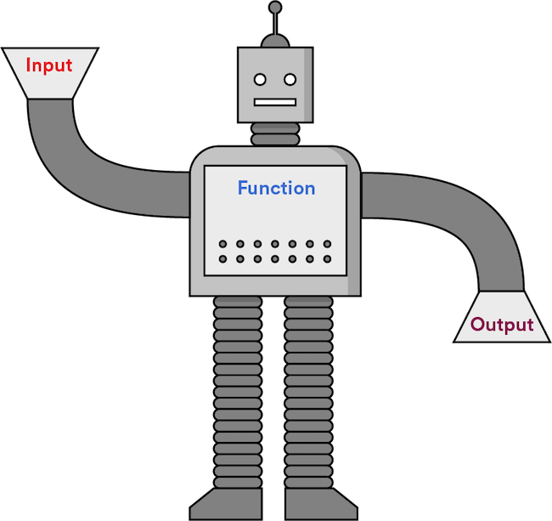
Functions
Functions are chunks of code that are grouped and execute together, like a modular program within a program.
A function takes input, performs logic, and returns output.

Slide 27
Functions
Reusable functions need names and follow naming rules that are identical to those of variables.
They must be called or “invoked” to execute and return a value.
They accept input, called parameters, that can be used inside the function.
function greetings(name) {
console.log(“Hello there, “ + name);
}
greetings(“Dave”);

Slide 28
Creating Functions in JS
30 minutes
Let’s create a few functions together, and then you’ll create a function of your own!
Starter code:
https://drive.google.com/drive/folders/1E8prrfiB5ZrLxmqPTd_mNR7HavSSm4CN?usp=sharing
Solution code:
https://drive.google.com/drive/folders/1O8my7O-8fAo16aaSWoxeCTWany8NPAKw?usp=sharing

Slide 29
Key Takeaways
For Next Time
Computers Think in Small Steps
JavaScript and the DOM
You can define functions to encapsulate common procedures.
Use variables for anything you need the computer to keep track of.
Use JavaScript to interact with elements on the page.
Respond to user actions by setting event listeners.
‹#› | © 2021 General Assembly

